Slide 1
Lecture 7: String Manipulation/ Functions
Dipendra Thapa
Dipendra.Thapa@icp.edu.np
CS4051 Fundamentals of Computing

Slide 2
This week
Functions - defining our own functions
Variable Scope
String manipulation

Slide 3
Functions
We have seen and used built in functions
Common ones are:
print(), input(), len(), int(), str(), float()

Slide 4
Functions
We have seen and used built in functions
Common ones are:
print(), input(), len(), int(), str(), float()
Some other useful ones are max(),min()
L = [55, 43, 1, 99]
print(max(L)) # prints out 99
print(min(L)) # prints out 1

Slide 5
Functions
reusable pieces/chunks of code
usually takes some input as parameters and gives out something as the result
functions are not run in a program until they are “called” or “invoked” inside a program

Slide 6
Functions
reusable pieces/chunks of code
usually takes some input as parameters and gives out something as the result
functions are not run in a program until they are “called” or “invoked” inside a program
function characteristics:
has a name
takes parameters (0 or more)
has a docstring (optional but recommended)
has a body
returns something

Slide 7
Defining functions
def add_two(a,b):
”””takes 2 numbers and returns sum”””
sum_ = a + b
return sum_

Slide 8
Defining functions
keyword
def add_two(a,b):
”””takes 2 numbers and returns sum”””
sum_ = a + b
return sum_

Slide 9
Defining functions
keyword
name
def add_two(a,b):
”””takes 2 numbers and returns sum”””
sum_ = a + b
return sum_

Slide 10
Defining functions
keyword
name
parameters
def add_two(a,b):
”””takes 2 numbers and returns sum”””
sum_ = a + b
return sum_

Slide 11
Defining functions
keyword
name
parameters
docstring, specifications of the function
def add_two(a,b):
”””takes 2 numbers and returns sum”””
sum_ = a + b
return sum_

Slide 12
Defining functions
keyword
name
parameters
docstring, specifications of the function
def add_two(a,b):
”””takes 2 numbers and returns sum”””
sum_ = a + b
return sum_
body of the function
the functions adds the two numbers and returns the sum

Slide 13
Call/Invoke a function
add_two(2,3) # call the function only
print(add_two(2,3)) # call and print output
print(add_two.__doc__) # print docstring

Slide 14
Call/Invoke a function
add_two(2,3) # call the function only
print(add_two(2,3)) # call and print output
print(add_two.__doc__) # print docstring
would call the function but result won’t be printed out as no print function is called

Slide 15
Call/Invoke a function
add_two(2,3) # call the function only
print(add_two(2,3)) # call and print output
print(add_two.__doc__) # print docstring
would call the function but result won’t be printed out as no print function is called
would call the function and print out what it returned,
again remember a function is being called inside a function here

Slide 16
Call/Invoke a function
add_two(2,3) # call the function only
print(add_two(2,3)) # call and print output
print(add_two.__doc__) # print docstring
would call the function but result won’t be printed out as no print function is called
would call the function and print out what it returned,
again remember a function is being called inside a function here
would print out the docstring defined inside the function, if no docstring is defined prints out None

Slide 17
If no return statement
def add_two(a,b):
”””takes 2 numbers and returns sum”””
sum_ = a + b
Python returns the value None, if no return is given
None represents the absence of a value

Slide 18
Variable scope
def add(a,b):
”””takes 2 numbers and returns sum”””
sum_ = a + b
return sum_
add(4,5)
print(sum_)

Slide 19

Variable scope
def add(a,b):
”””takes 2 numbers and returns sum”””
sum_ = a + b
return sum_
add(4,5)
print(sum_)
you can’t do this because, sum_ is a local variable defined inside the function, locals variables are not accessible outside the function

Slide 20
Variable scope
def add(a,b):
”””takes 2 numbers and returns sum”””
sum_ = a + b
return sum_
sum_ = add(4,5)
print(sum_)

Slide 21
Variable scope
def add(a,b):
”””takes 2 numbers and returns sum”””
sum_ = a + b
return sum_
sum_ = add(4,5)
print(sum_)
local variable, defined inside of the function

Slide 22
Variable scope
def add(a,b):
”””takes 2 numbers and returns sum”””
sum_ = a + b
return sum_
sum_ = add(4,5)
print(sum_)
local variable, defined inside of the function
this would be valid because the value of the local variable sum_ which is returned by the function is stored in the new global variable sum_ defined outside the function, even though they have the same name they are different variables !! one is local and another is global
global variable, defined outside of the function

Slide 23
Global and local variables
global variables are variables declared outside functions and can be accessed from anywhere within the program
local variables are variables declared inside a function and can be used only inside that particular function
inside a function, a variable which is defined outside the function can be accessed even if not explicitly passed as arguments

Slide 24
Example
def add():
sum_ = a + b # adding global a and global b
return sum_
a = 2 # a is global & accessible inside function
b = 3 # b is global & accessible inside function
print(add()) # prints 5
although this is possible, its not recommended to do so !!
also this is not quite useful as the function would return the same value every time unless the values of a and b are changed

Slide 25
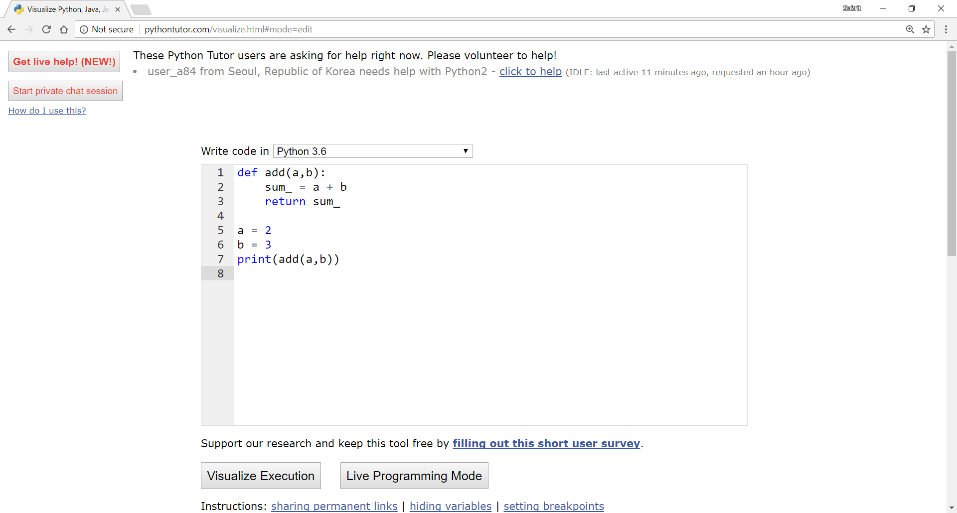
Visualize how your program is working
Python Tutor is your best friend to do this www.pythontutor.com

Slide 26
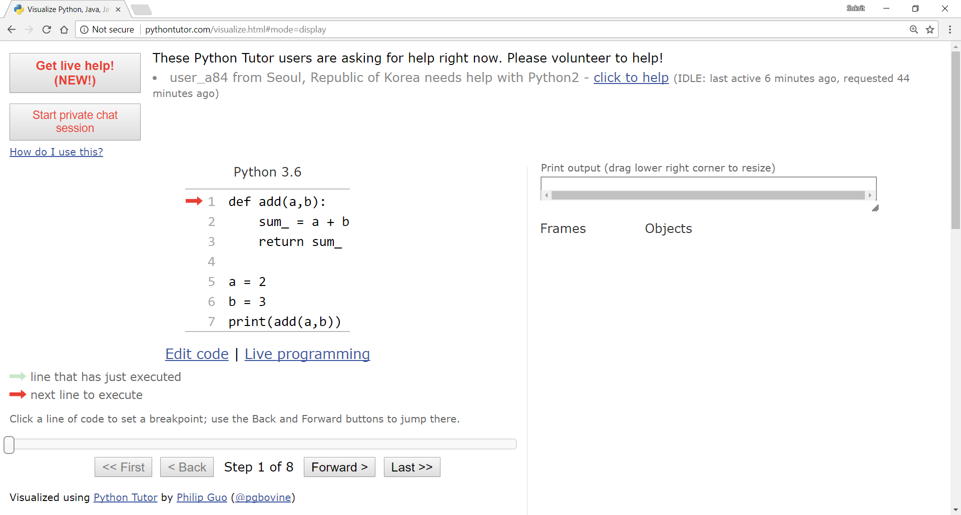
Variable scope visualization - example 1

Slide 27
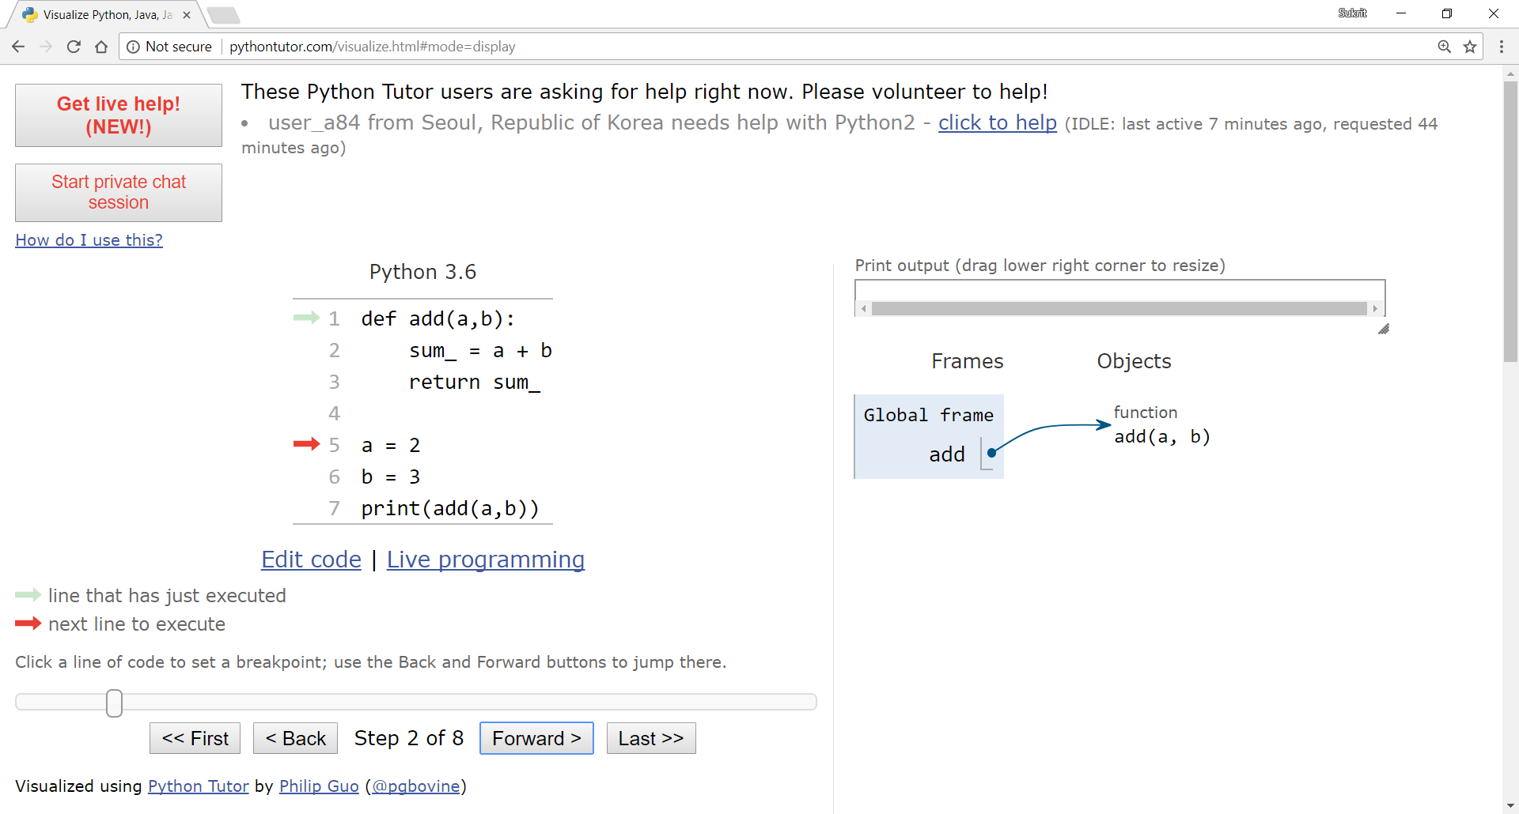
Variable scope visualization - example 1

Slide 28
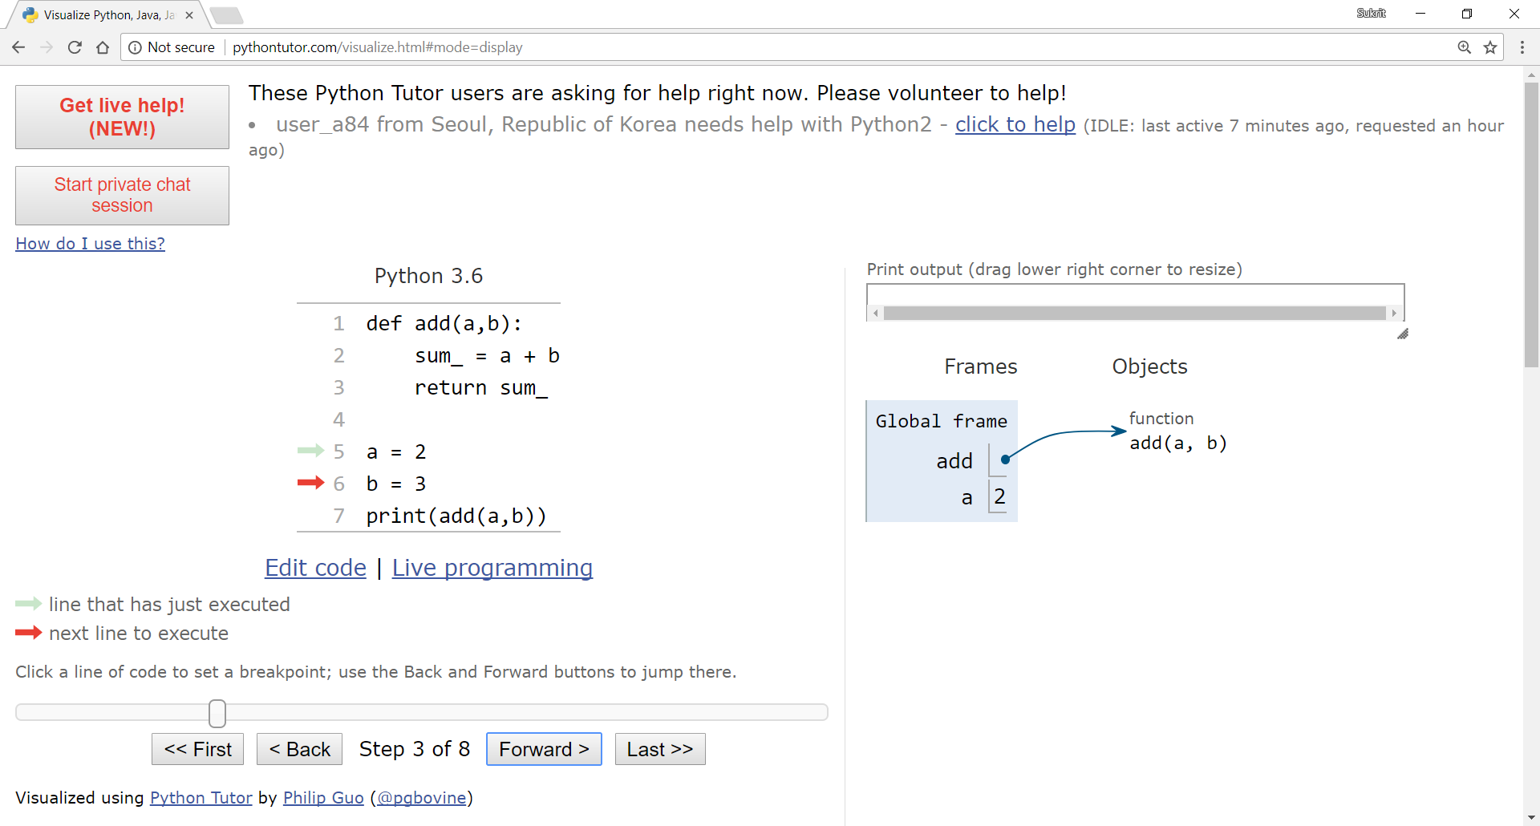
Variable scope visualization - example 1

Slide 29
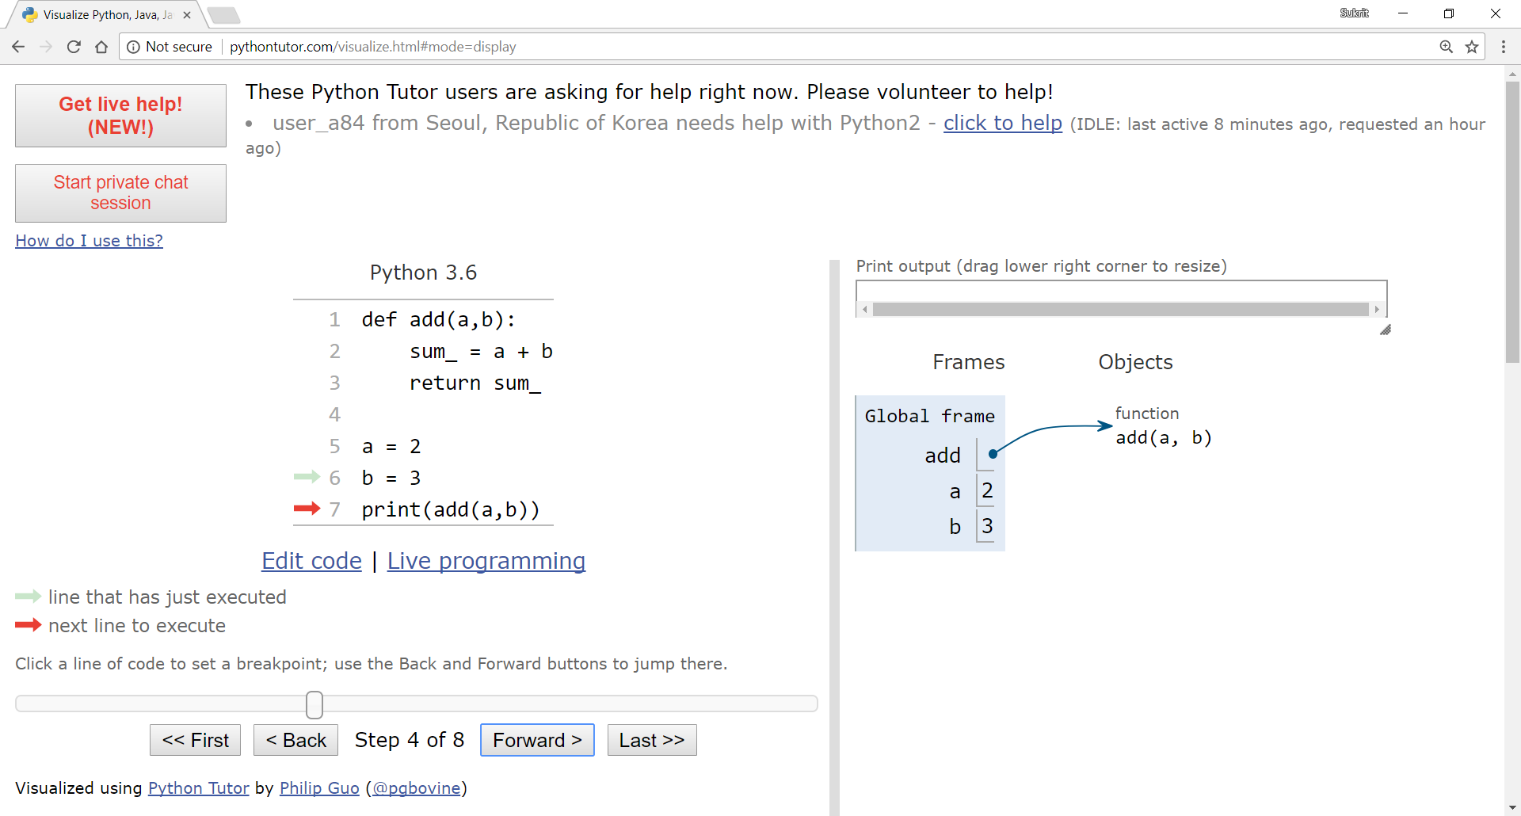
Variable scope visualization - example 1

Slide 30
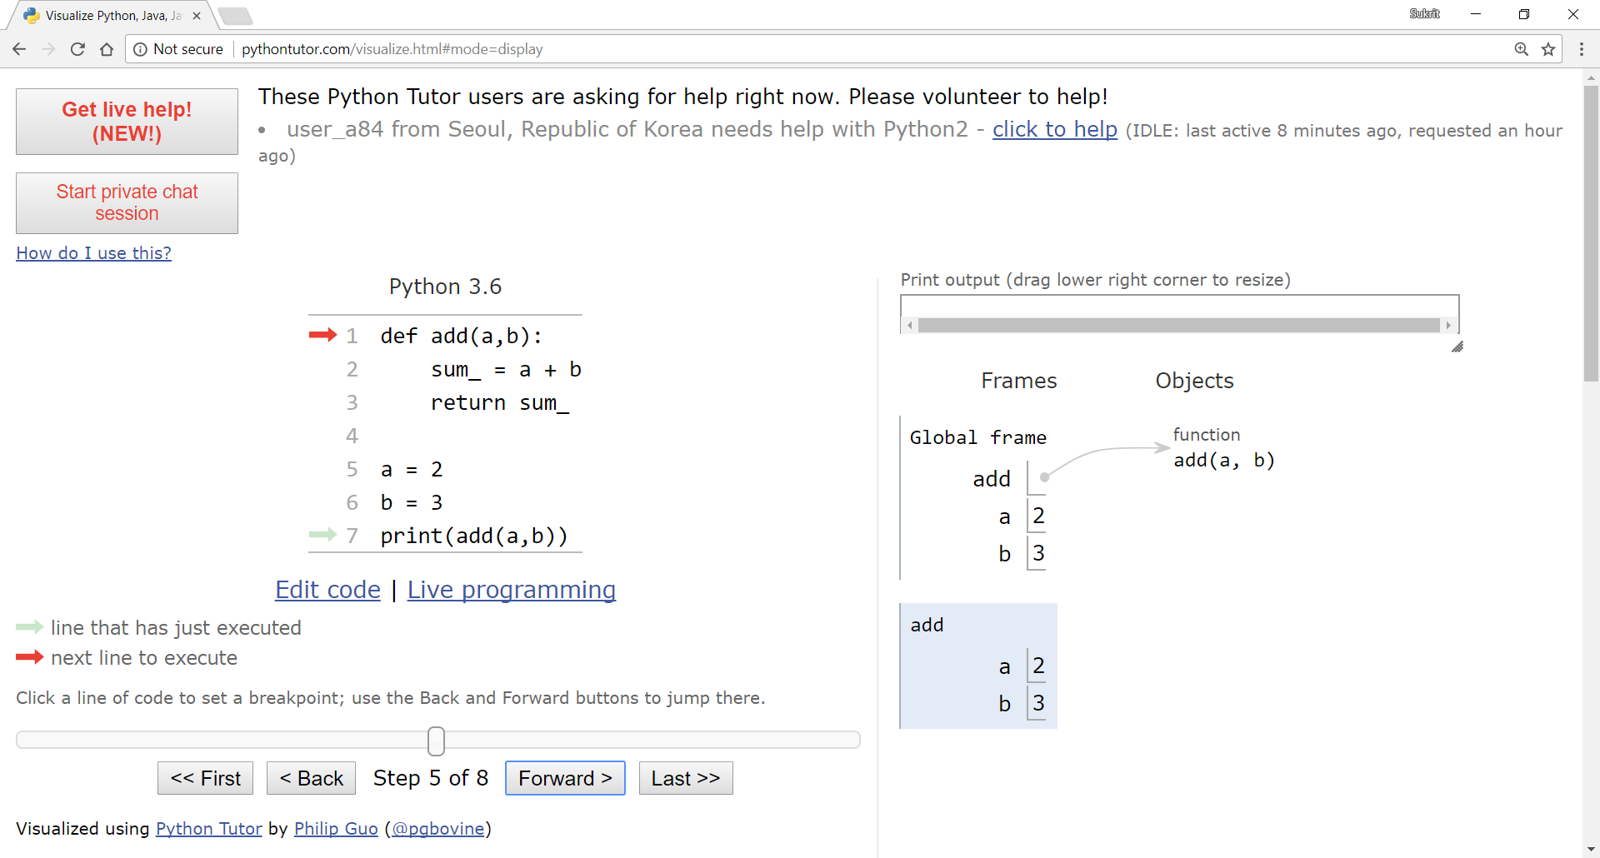
Variable scope visualization - example 1

Slide 31

Variable scope visualization - example 1

Slide 32
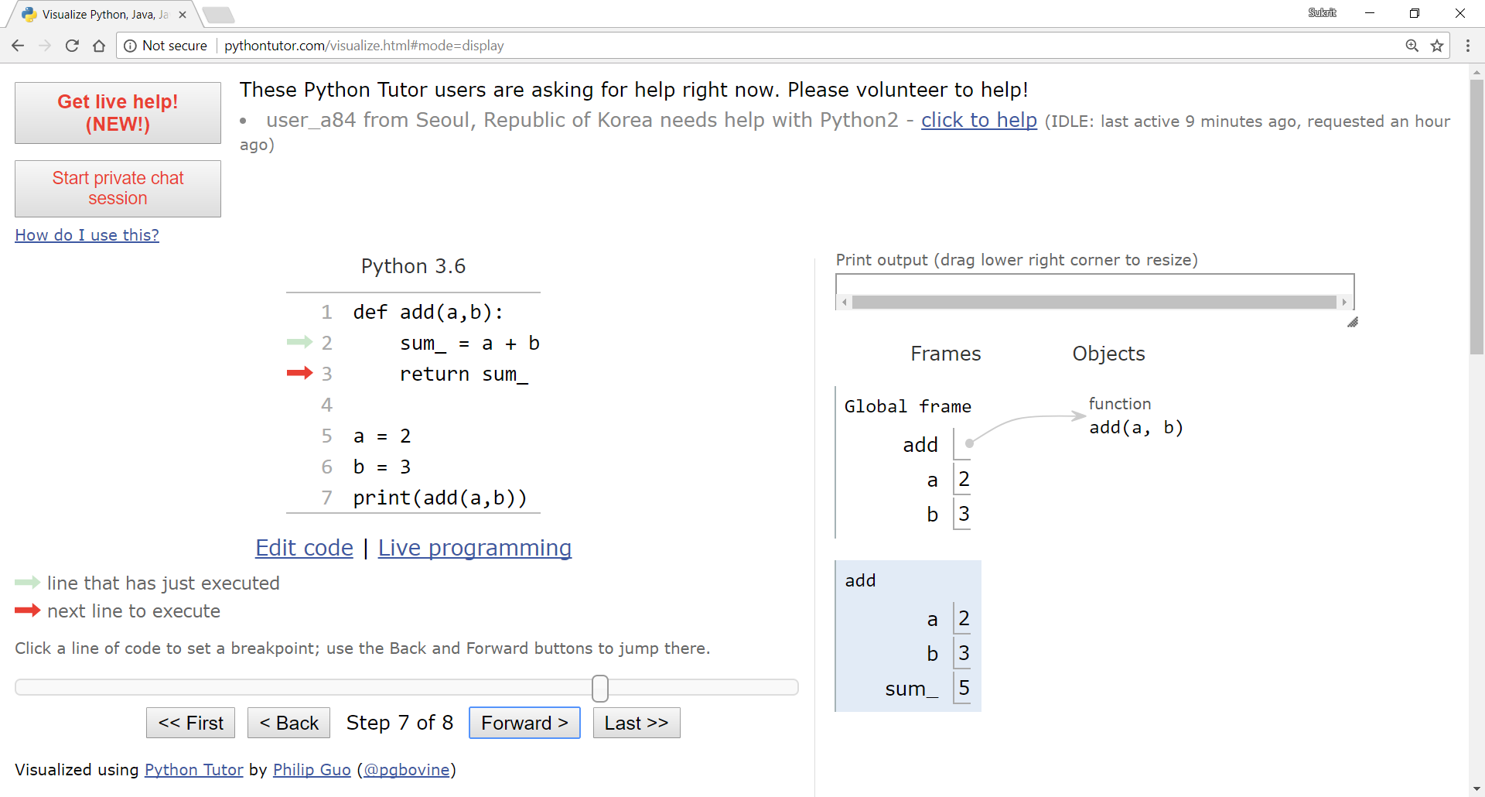
Variable scope visualization - example 1

Slide 33
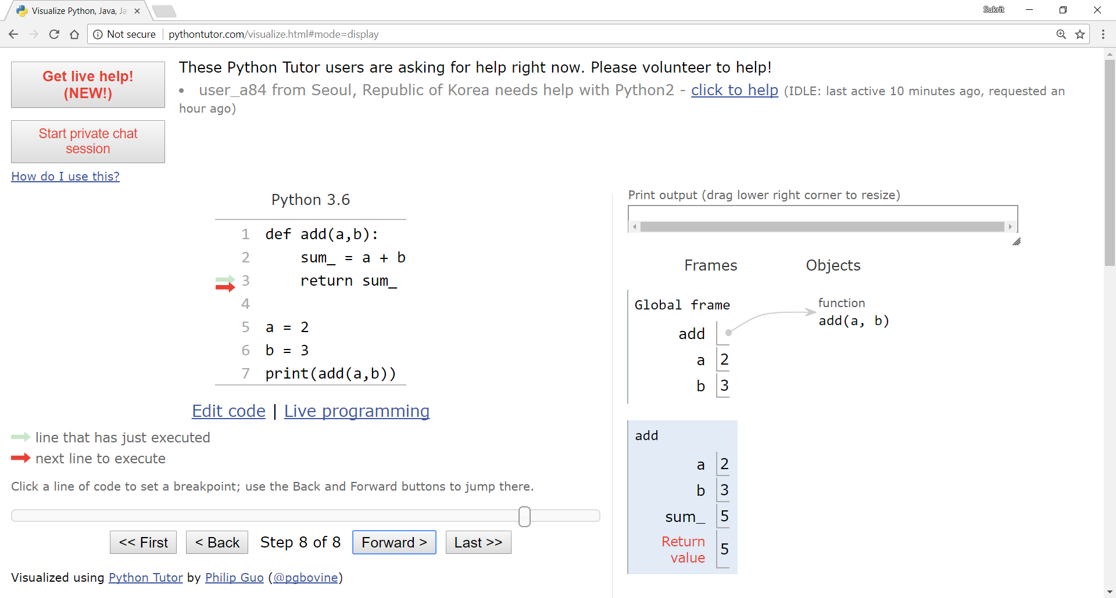
Variable scope visualization - example 1

Slide 34
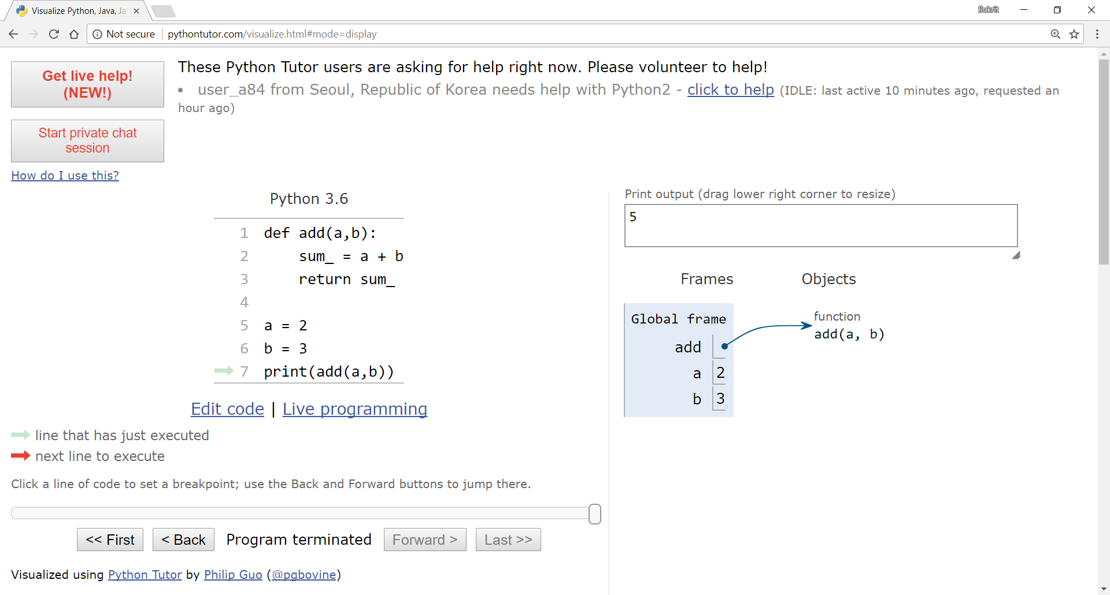
Variable scope visualization - example 1

Slide 35
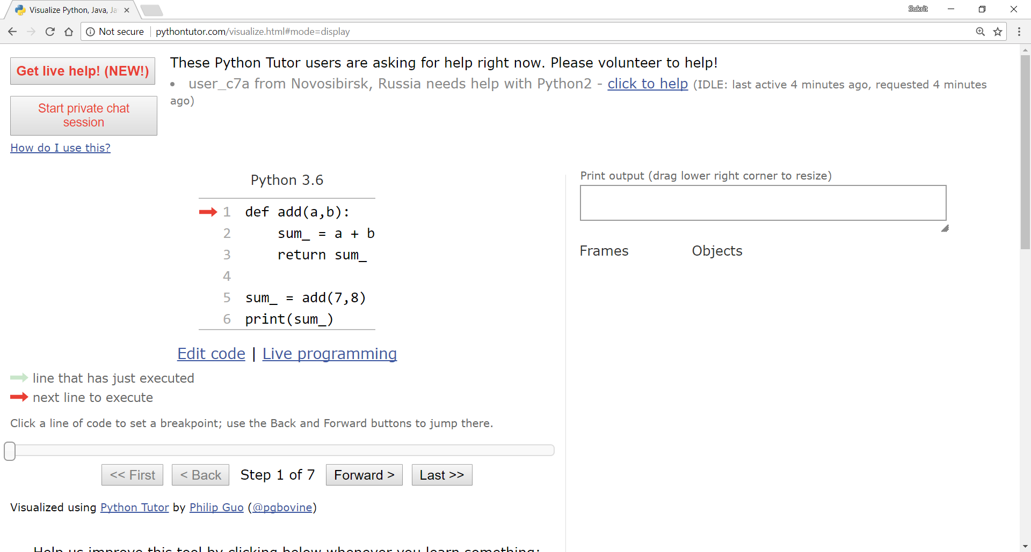
Variable scope visualization – example 2

Slide 36
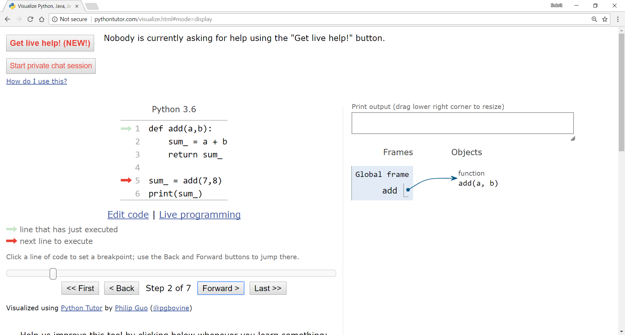
Variable scope visualization – example 2

Slide 37
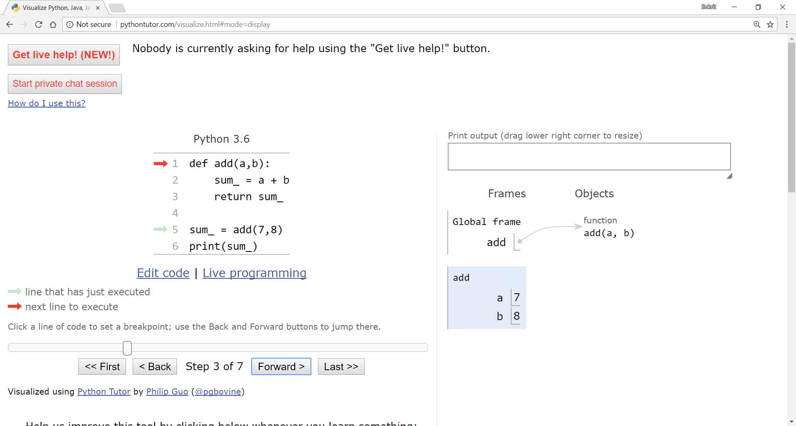
Variable scope visualization – example 2

Slide 38
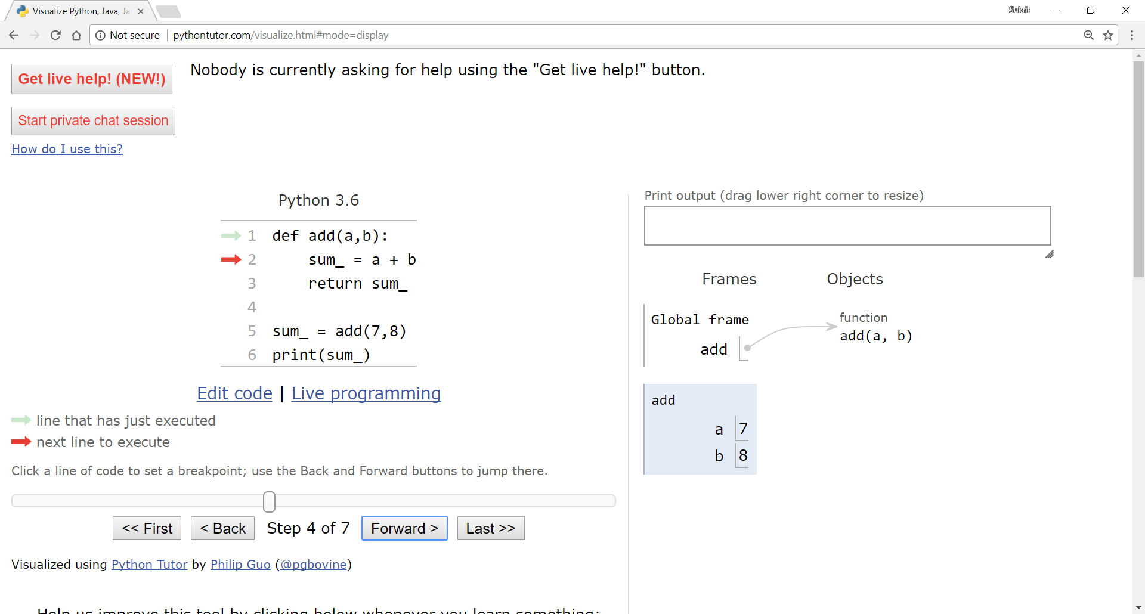
Variable scope visualization – example 2

Slide 39
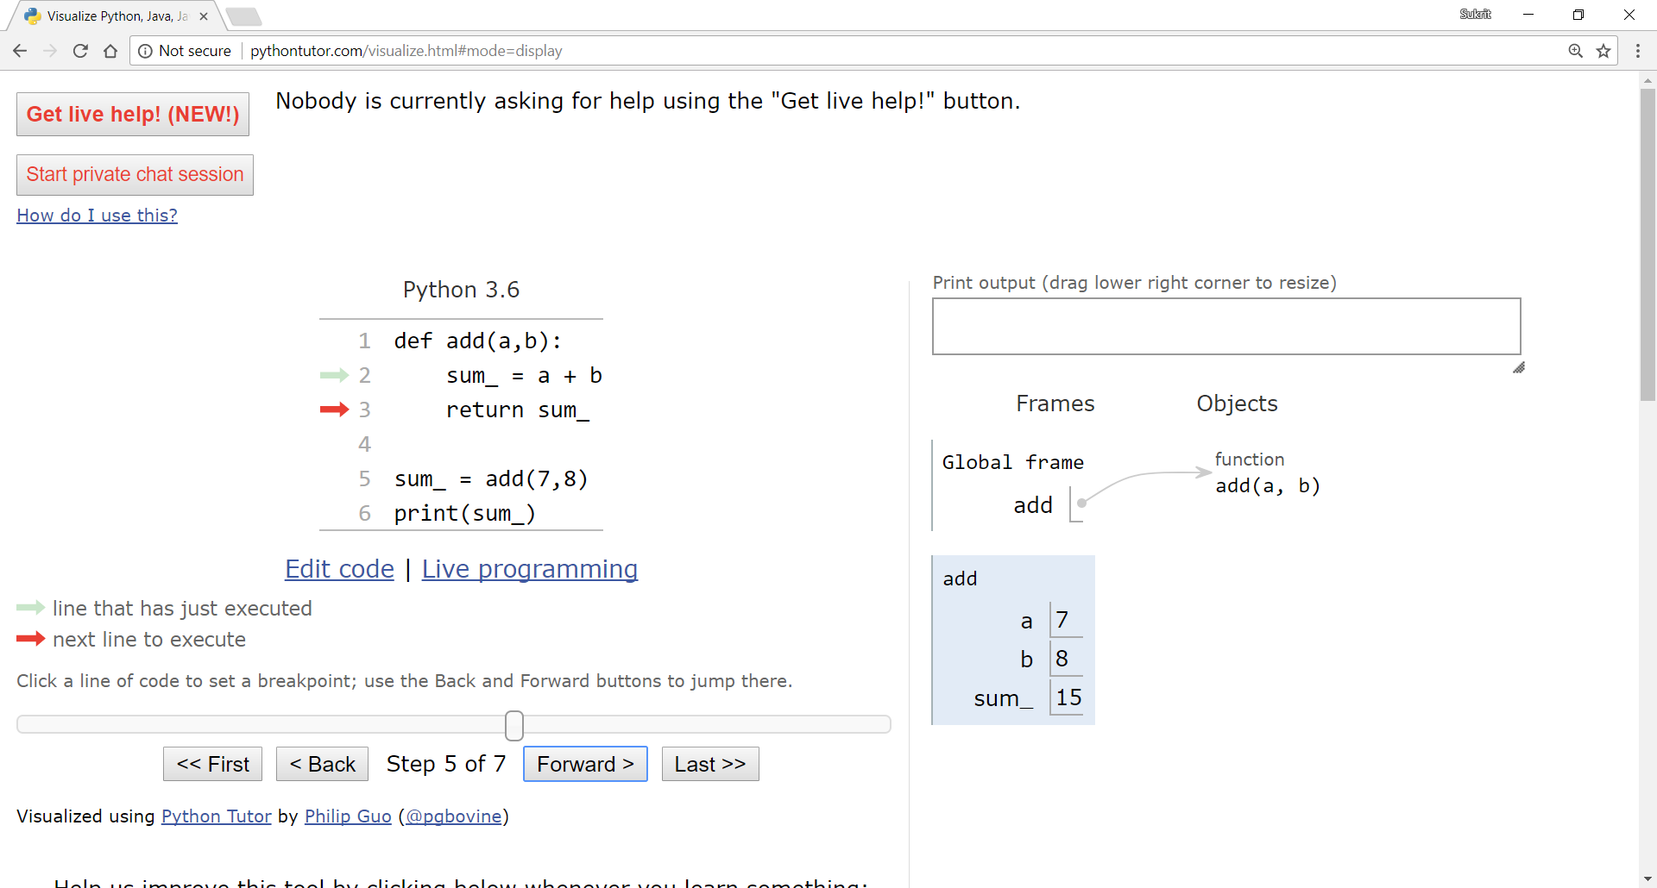
Variable scope visualization – example 2

Slide 40
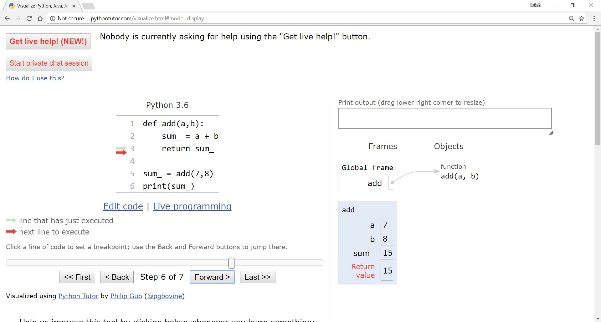
Variable scope visualization – example 2

Slide 41
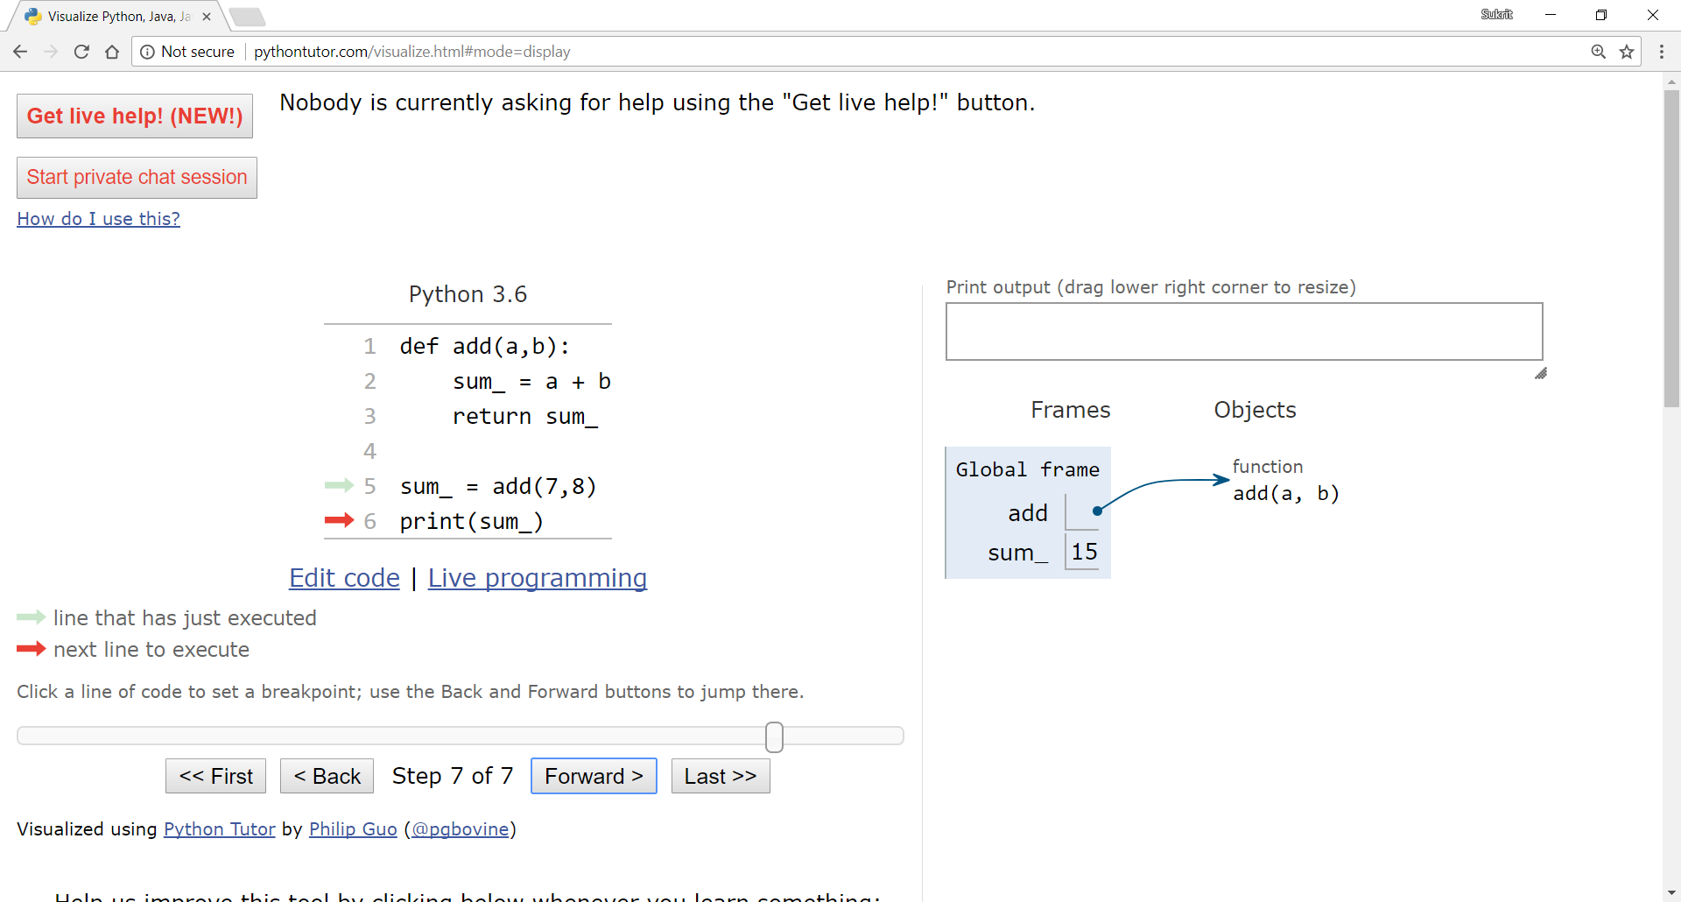
Variable scope visualization – example 2

Slide 42
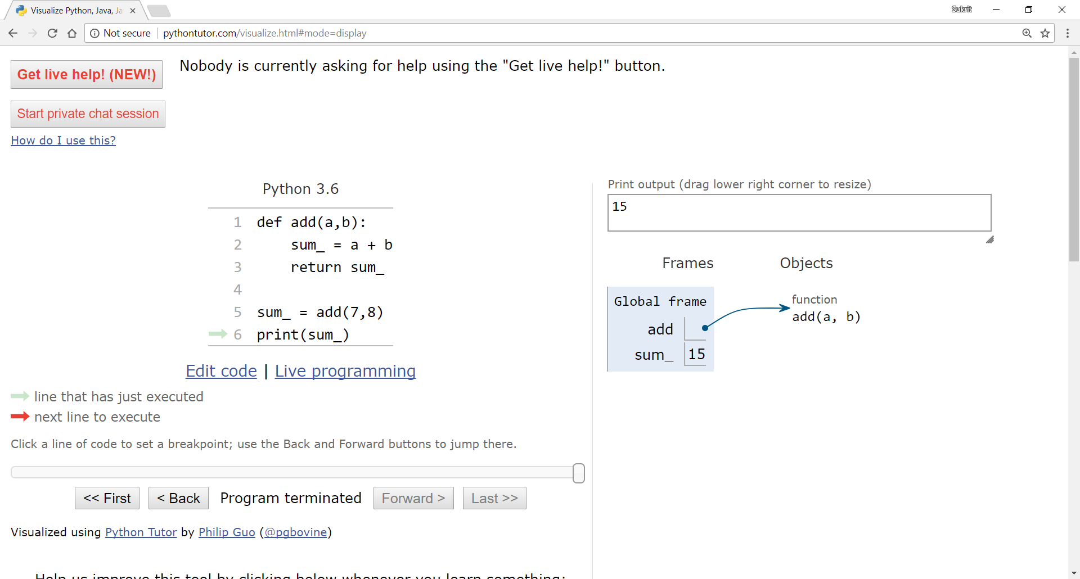
Variable scope visualization – example 2

Slide 43
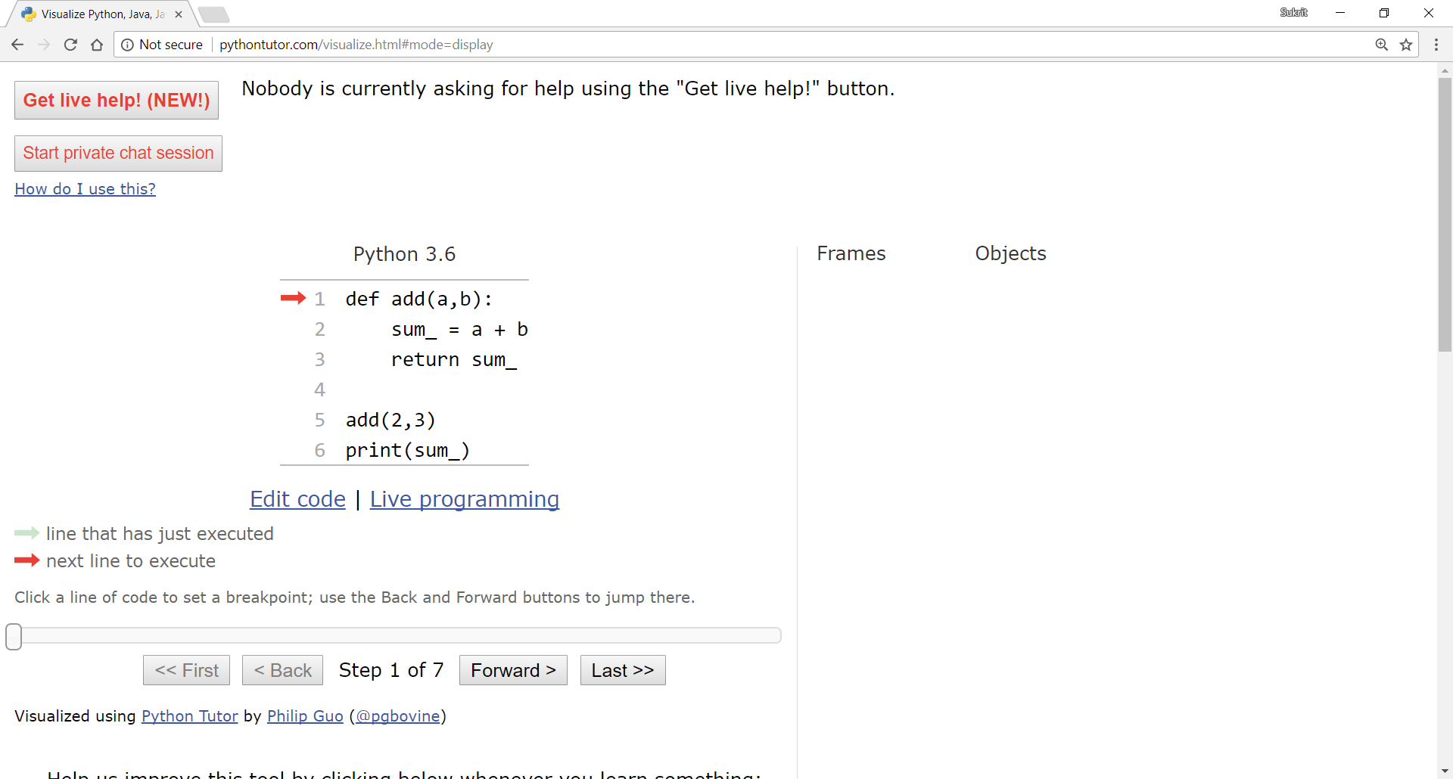
Variable scope visualization – example 3

Slide 44
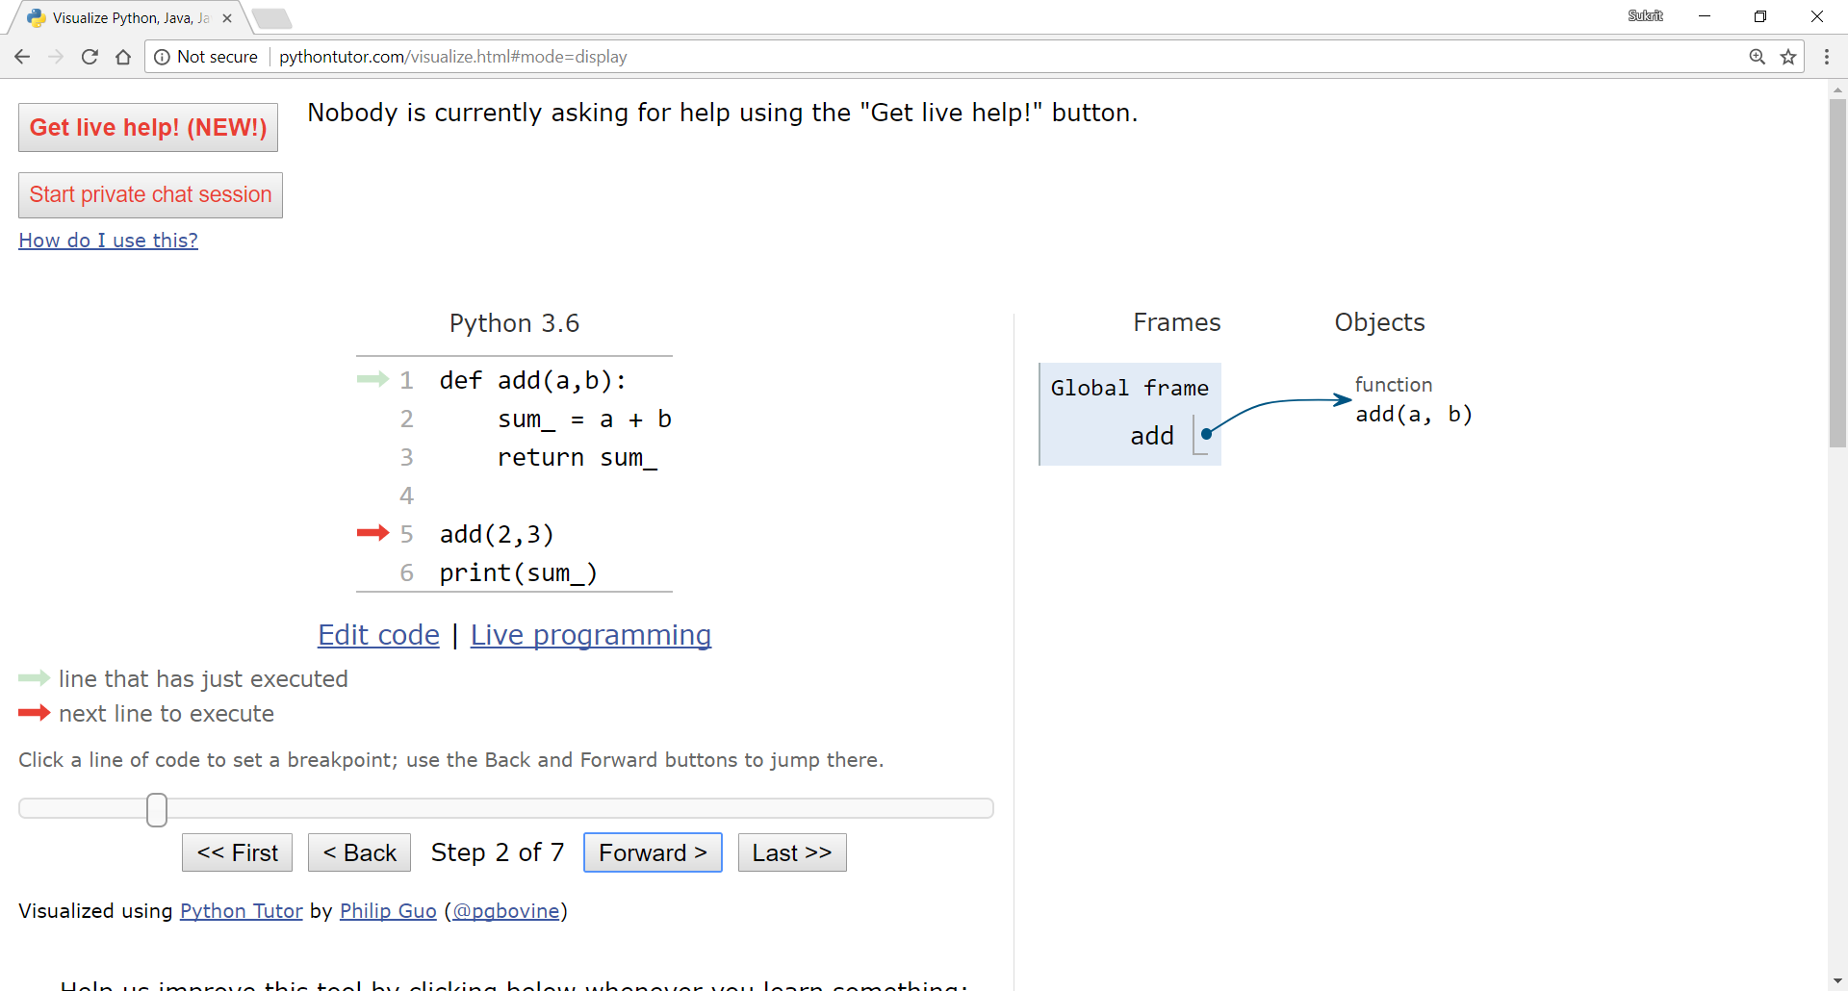
Variable scope visualization – example 3

Slide 45
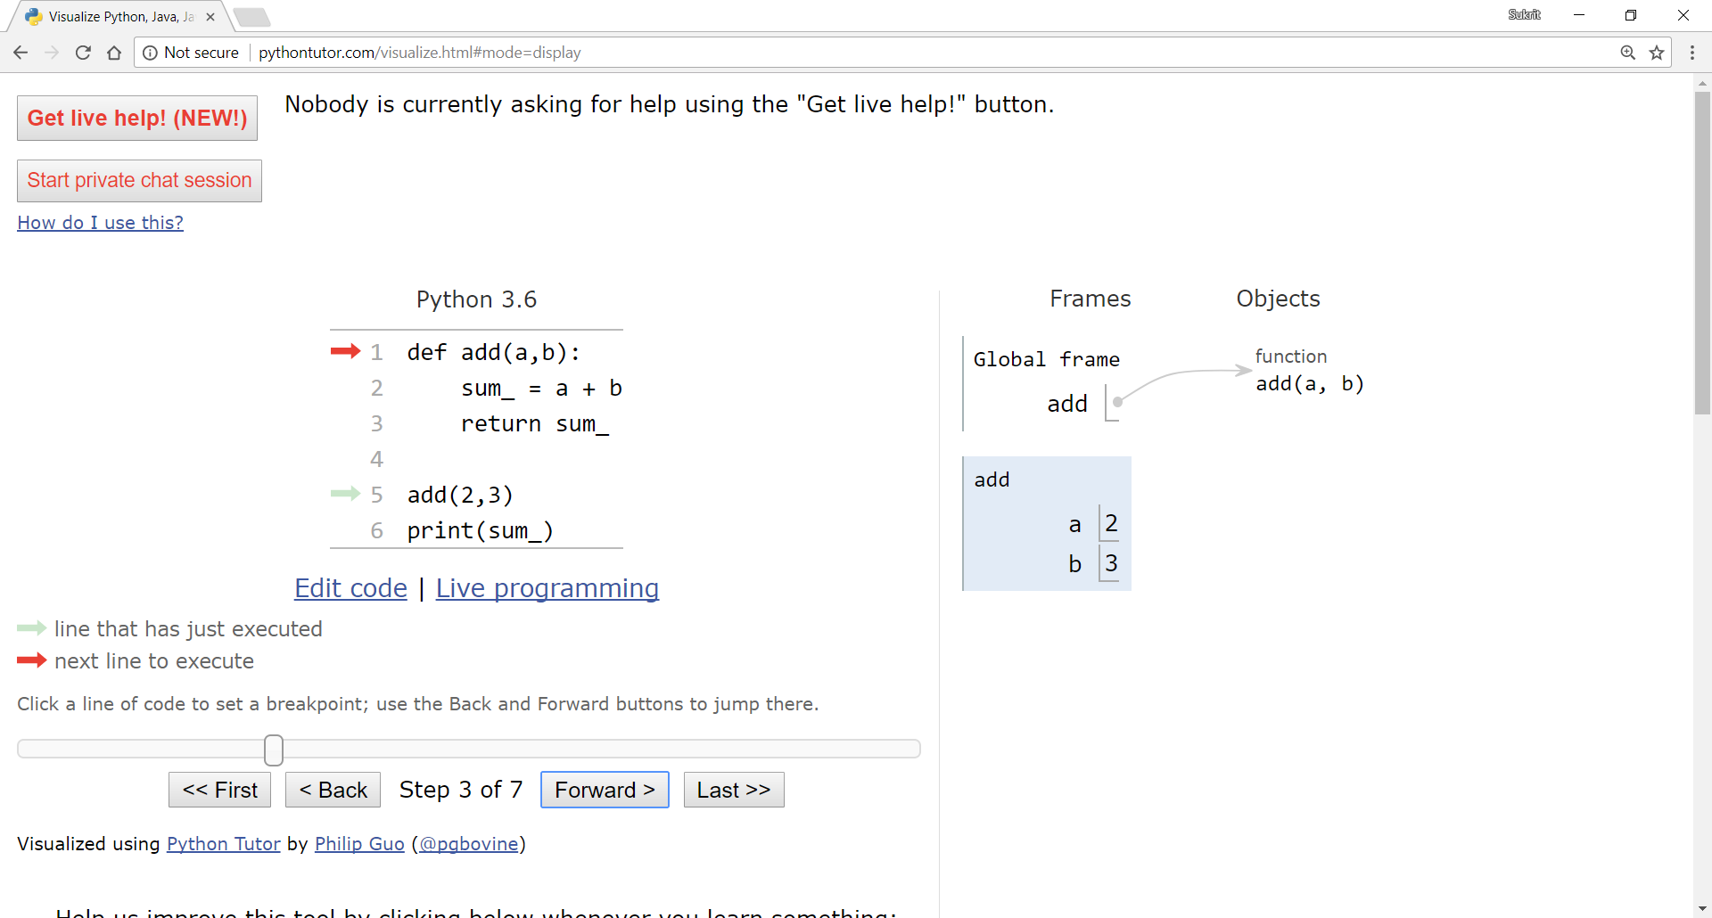
Variable scope visualization – example 3

Slide 46

Variable scope visualization – example 3

Slide 47
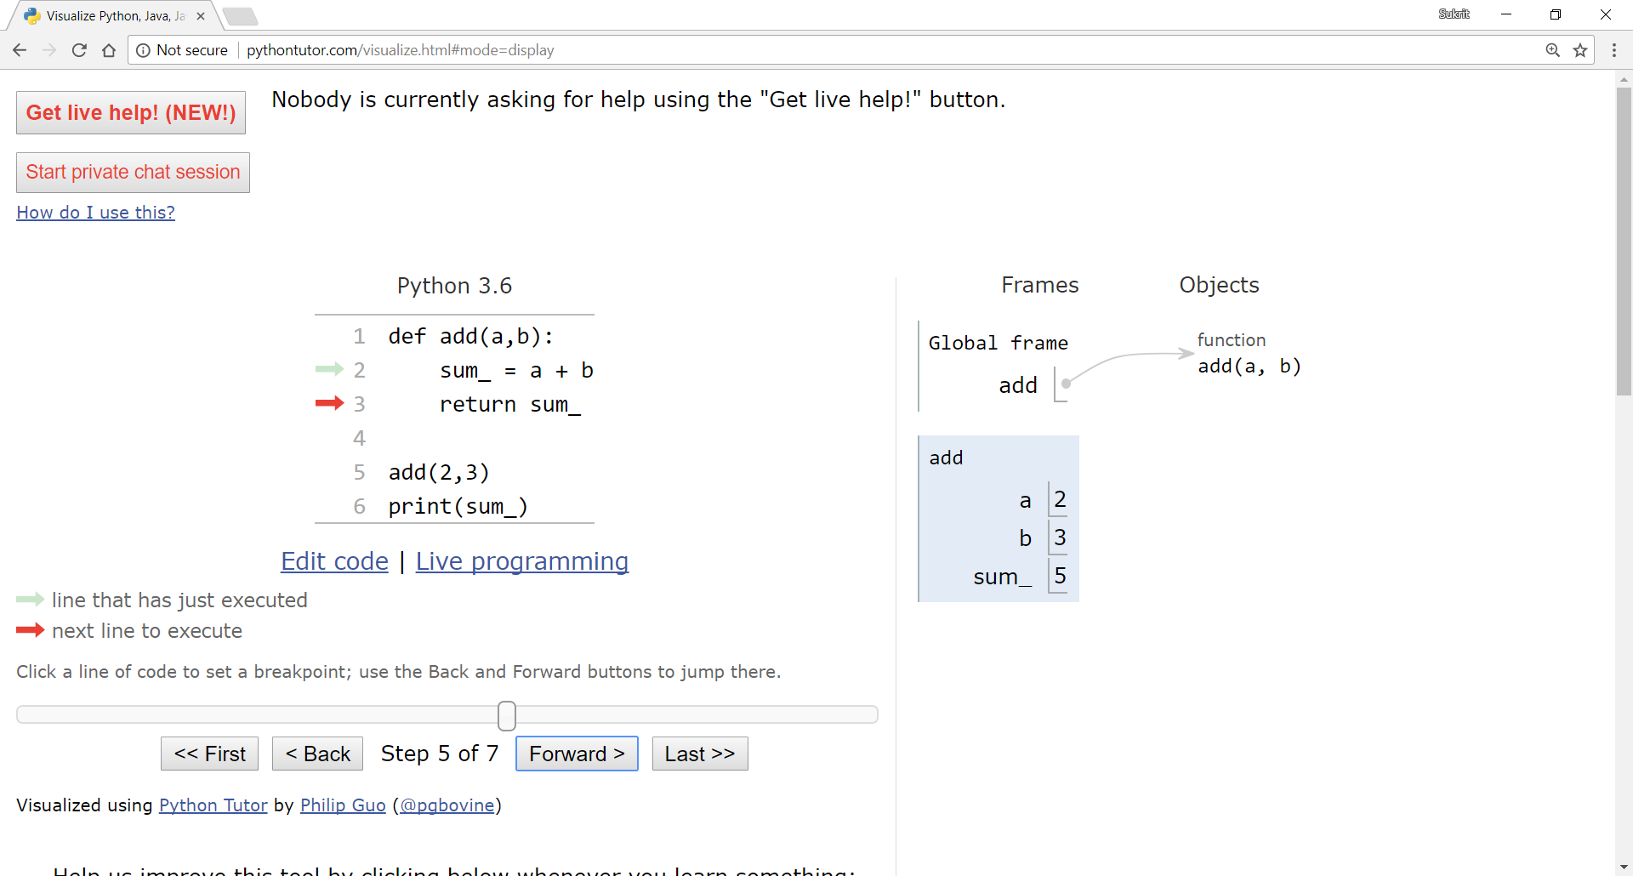
Variable scope visualization – example 3

Slide 48
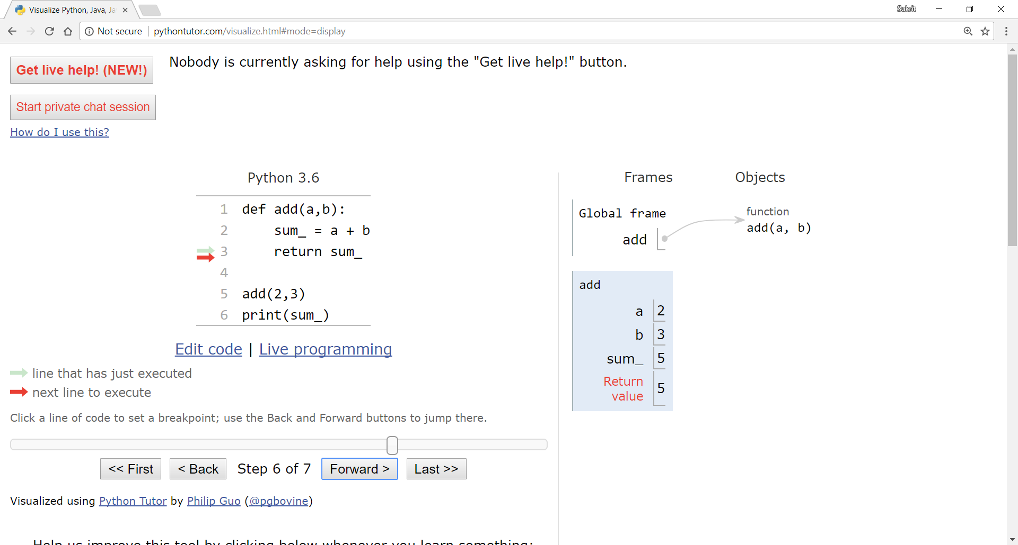
Variable scope visualization – example 3

Slide 49
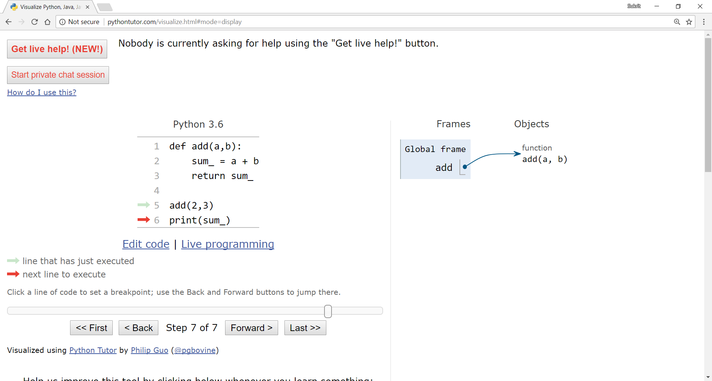
Variable scope visualization – example 3

Slide 50
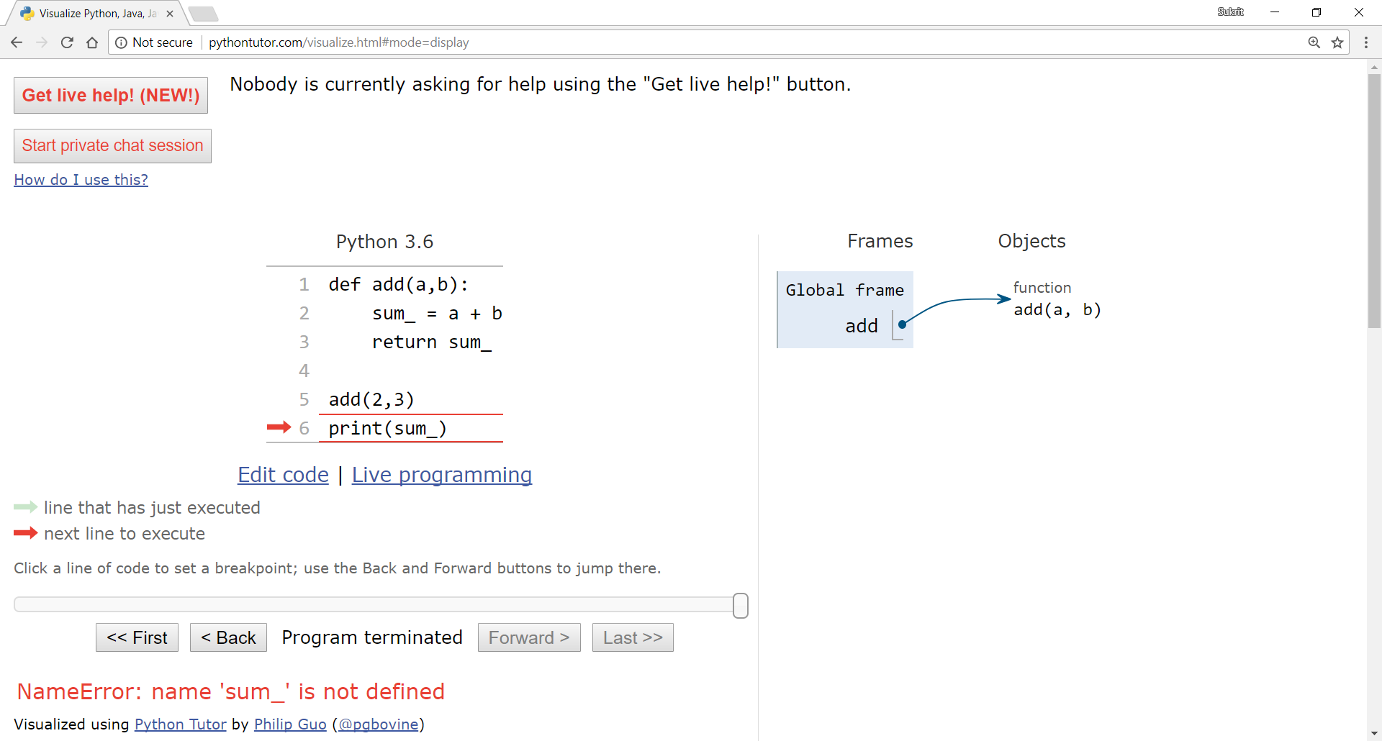
Variable scope visualization – example 3

Slide 51
Strings
Think of strings as a sequence of characters
Strings are immutable, you can’t modify the original string once you’ve created it
Strings have some similar functionalities as lists
s = “Hello”
print(len(s)) # prints out 5
print(s[0]) # prints out ‘H’
print(s[-1]) # prints out ‘o’

Slide 52
Useful functions
s = “Hello”
print(s.upper()) # prints out “HELLO”
print(s.lower()) # prints out “hello”
print(s) # prints out “Hello”
s_u = s.upper()
s_l = s.lower()
since strings are immutable, the original string won’t be changed, if you want to save the upper and lower case versions you need to assign it to another variable

Slide 53
Useful functions
s = “Hello”
print(s.replace(‘H’,‘h’)) # prints ‘hello’
ss = s.replace(‘H’,‘h’)
# ss = “hello”
here too, the original string won’t be changed, a new version of the string with ‘H’ replaced by ‘h’ will be printed out, to save it assign it to another variable

Slide 54
Useful functions
s = “Hello”
print(s.replace(‘H’,‘h’)) # prints ‘hello’
ss = s.replace(‘H’,‘h’)
# ss = “hello”
print(s.count(‘l’)) # prints 2
print(s.count(‘h’)) # prints 0
print(ss.count(‘h’)) # prints 1
here too, the original string won’t be changed, a new version of the string with ‘H’ replaced by ‘h’ will be printed out, to save it assign it to another variable

Slide 55
Strings to Lists
s = “Hello”
l = list(s) # l = ['H', 'e', 'l', 'l', 'o']
l.count(‘H’) # prints 1

Slide 56
Strings to Lists
s = “Hello”
l = list(s) # l = ['H', 'e', 'l', 'l', 'o']
l.count(‘H’) # prints 1
a = ‘’.join(l) # a = ‘Hello’
b = ‘*’.join(l) # b = ‘H*e*l*l*o’
lists can be converted into strings using the join function, but join can only convert a list of strings into a single string

Slide 57
Strings into Lists
s = "Words can be separated in this way."
x = s.split()
# x = ['Words','can','be','separated','in',‘this','way.']
y = " ".join(x)
# y = 'Words can be separated in this way.‘

Slide 58
Strings into Lists
s = "Words can be separated in this way."
x = s.split()
# x = ['Words','can','be','separated','in',‘this','way.']
y = " ".join(x)
# y = 'Words can be separated in this way.‘
print(list(s))
what do you think this will do, try it yourself

Slide 59
Strings into Lists
p = ‘apple orange mango’
fruits = p.split()
# fruits = [‘apple’,‘orange’,‘mango’]
when just calling split without any parameters it will divide the string according to whitespace, you can also specify a specific character according which to split the string

Slide 60
Strings into Lists
p = ‘apple orange mango’
fruits = p.split()
# fruits = [‘apple’,‘orange’,‘mango’]
p = ‘apple,orange,mango’
fruits = p.split(‘,’)
# fruits = [‘apple’,‘orange’,‘mango’]
when just calling split without any parameters it will divide the string according to whitespace, you can also specify a specific character according which to split the string

Slide 61
Iterating through strings
>>>
H
e
l
l
o
W
o
r
l
d
s = ‘Hello World’
for letter in s:
print(letter)
for i in range(len(s)):
print(s[i])

Slide 62
End of Lecture 7

Slide 63
Thank you ! Any questions ?

